Slide 1
Project Presentation
Vineet Gali

Slide 2
Overview: Artist Prediction from Song Lyrics
Traditional musical analysis centers around various audio features
Tempo
Rhythm
Pitch
Using Machine Learning we can analyze lyrics
Word count
Conceptual themes

Slide 3
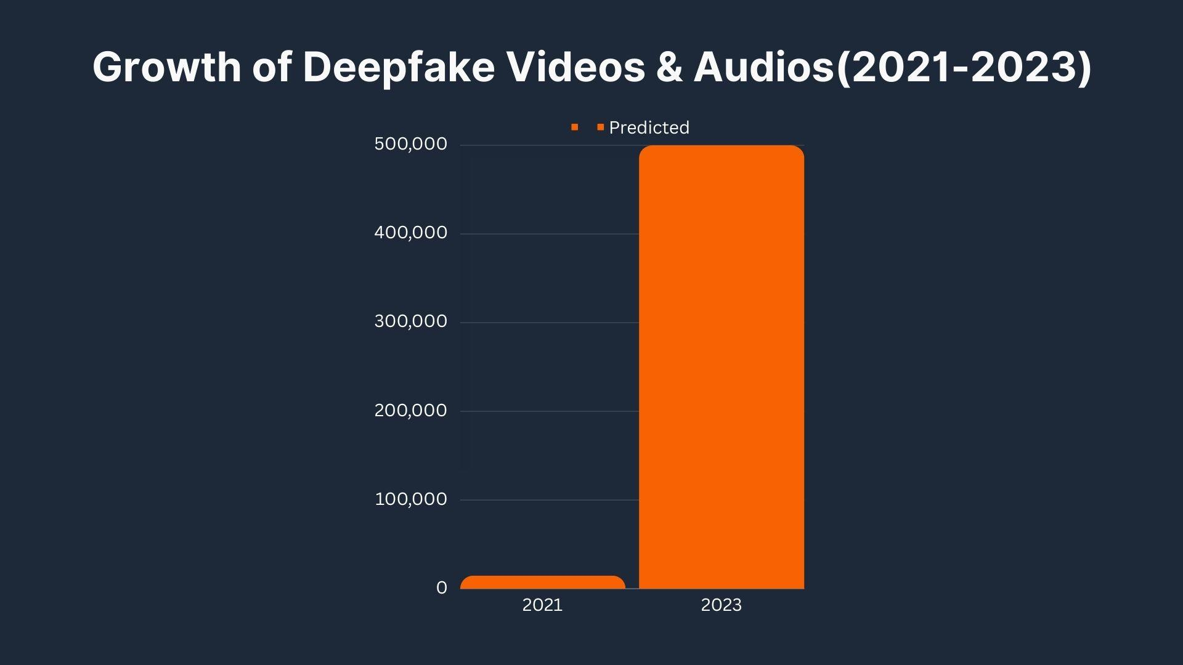
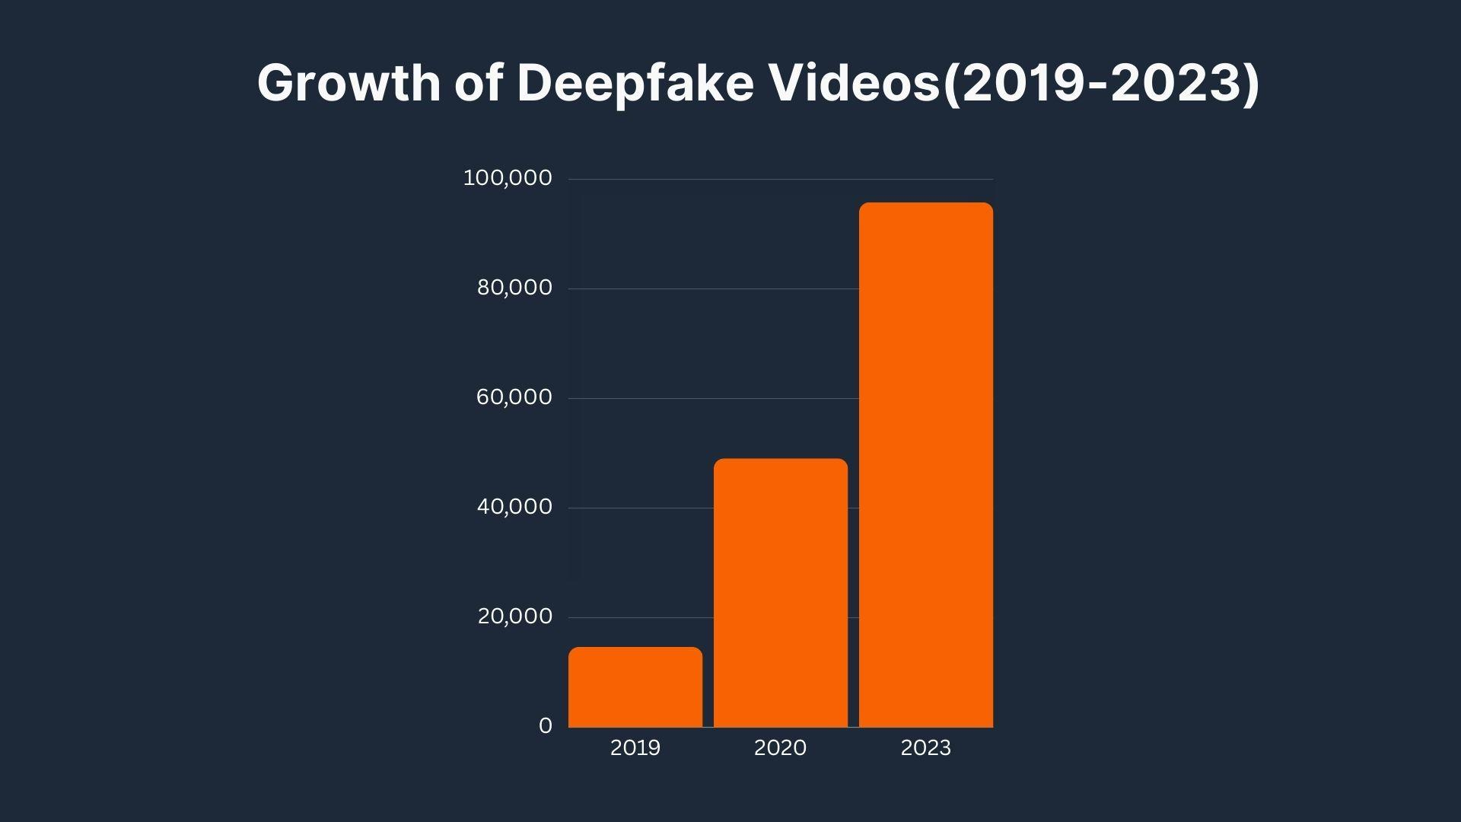
Importance
In 2023, there was a notable surge in the popularity of viral artificial intelligence-themed songs
This places an artist's reputation and livelihood at stake

Slide 4


Dataset - Kaggle
Kaggle is a platform for data science and machine learning
Shrirang Mahajan - Spotify Million Song Dataset
Contains corresponding songs, lyrics, and artist names

Slide 5
Outline
Data Preprocessing
Cleaning
Feature engineering
Data splitting
Traditional Machine Learning
K-Nearest Neighbors
Decision Tree
Random Forest
Gradient Boosting
Deep Learning
Feed-Forward Neural Network
Neural Embedding
Recurrent Neural Network (LSTM)

Slide 6
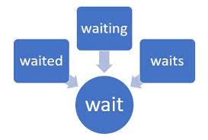
Data Preprocessing
Raw text data must be transformed into a format suitable for machine learning models
Removing irrelevant characters
Removing stopwords
Punctuation
Text tokenization/stemming

Slide 7

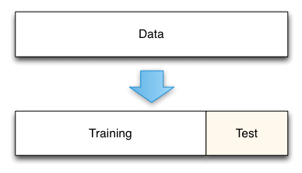
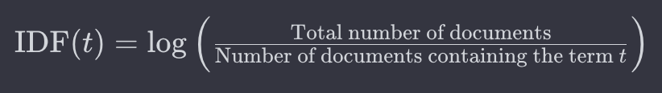
Feature Engineering
TfidfVectorizer
Text frequency (TF)
Inverse document frequency (IDF)
Train/Test Splitting
Maintain artist distribution in train and test data
Ensure reproducibility in code

Slide 8
Text Tokenization/Stemming
Regular Expression Tokenizer
Character tokenization
Does not include punctuation
Alternatives
Sentence tokenizer
Word tokenizer (punctuation)
Blank tokenizer
Snowball Stemmer
Most meaningful stemmer
Language-agnostic
Alternatives
Porter stemmer (least aggressive)
Lancaster stemmer (most aggressive)

Slide 9
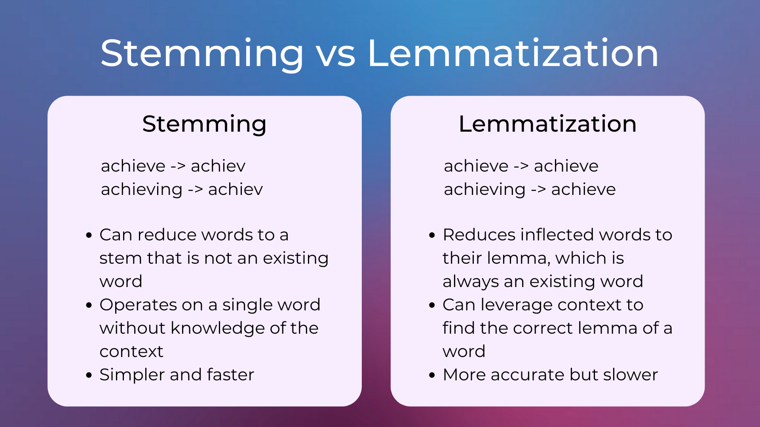
Natural Language Processing Libraries
Natural Language Toolkit (NLTK)
Stemming
Vectorization & Embedding
Simplicity
SpaCy
Lemmatization
Embedding
Scalability
Hugging Face
No preprocessing methods
Dependent on pre-trained models

Slide 10
Machine Learning Libraries
Sci-kit Learn
Simplicity for traditional machine learning
No deep learning
Robustness
Pytorch
Deep learning compatibility
Dynamic nature during runtime
TensorFlow
Deep learning compatibility
Static nature during runtime

Slide 11
Data Visualization
Confusion matrix
Extension of sci-kit learn library
Comprehensive performance overview
True positives, false positives
Color coded
Ipywidgets Library
Created for Jupyter compatible environments
Provides interactive HTML widgets
Visualize data in real time

Slide 12
Traditional Machine Learning
K-Nearest Neighbors - Classifying data points based on its nearest neighbors
Decision Tree - Classifying data by recursively splitting into a tree
Random Forest - Building multiple weak decision trees and using majority vote
Gradient Boosting - Iteratively training a weak decision tree to improve performance

Slide 13
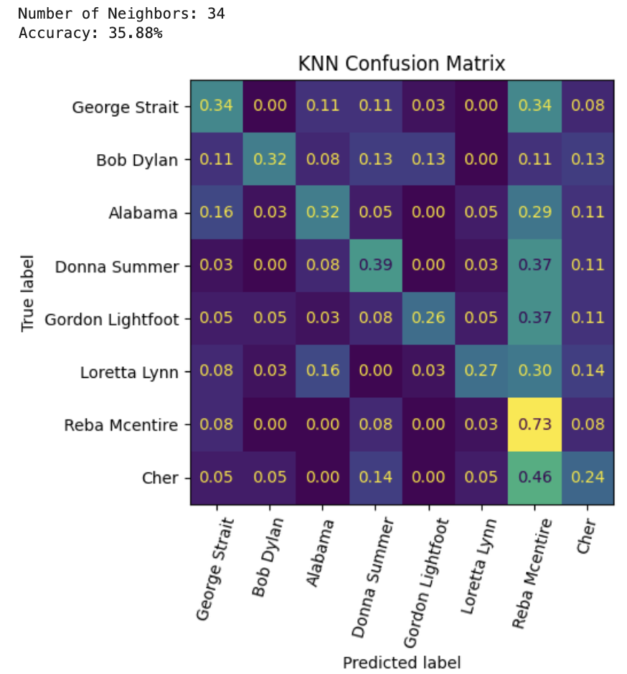
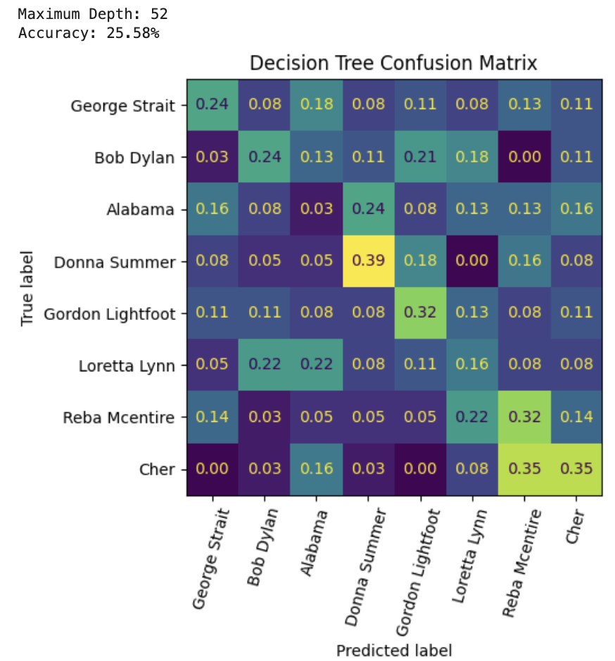
Performance Results - Traditional Machine Learning
K-Nearest Neighbors
Decision Tree

Slide 14
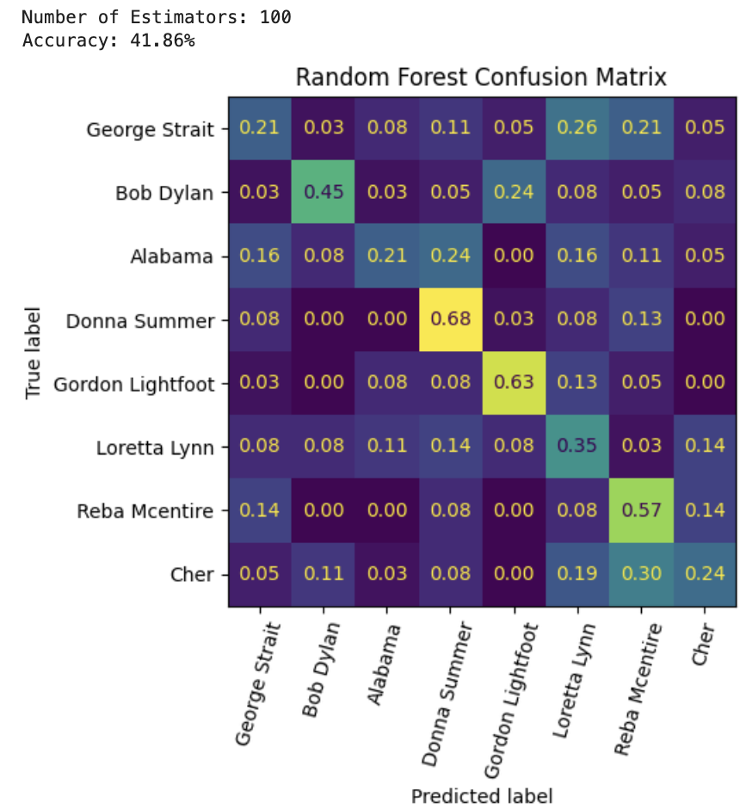
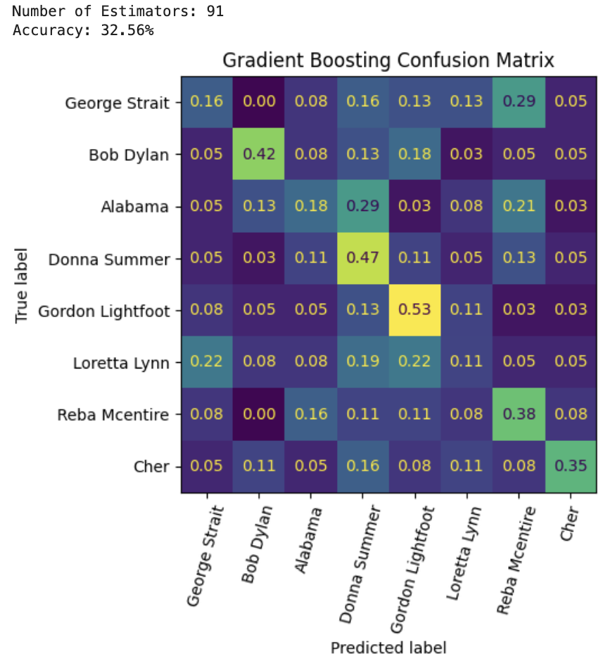
Performance Results - Traditional Machine Learning
Random Forest
Gradient Boosting

Slide 15
Deep Learning
Neural Networks - artificial neurons designed to model and process data connections
Feed Forward Neural Network
Simplest neural network
Data flows unidirectionally
Neural Embedding
Data uses semantic relationships
Recurrent Neural Network
Uses temporal relationships

Slide 16
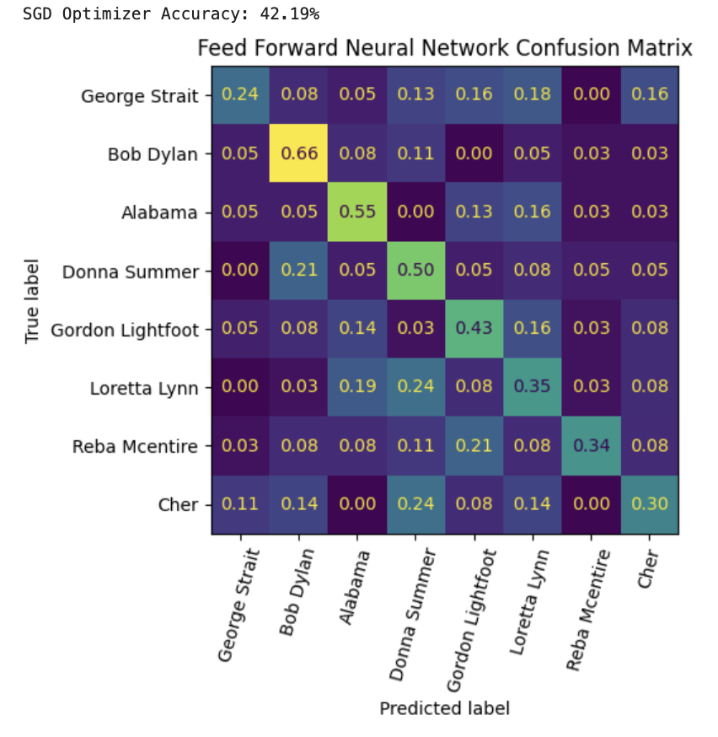
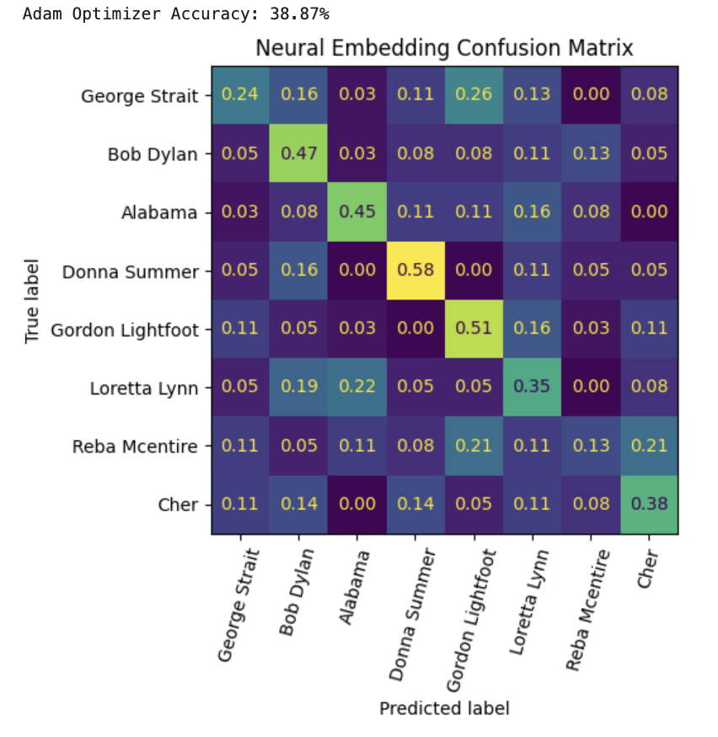
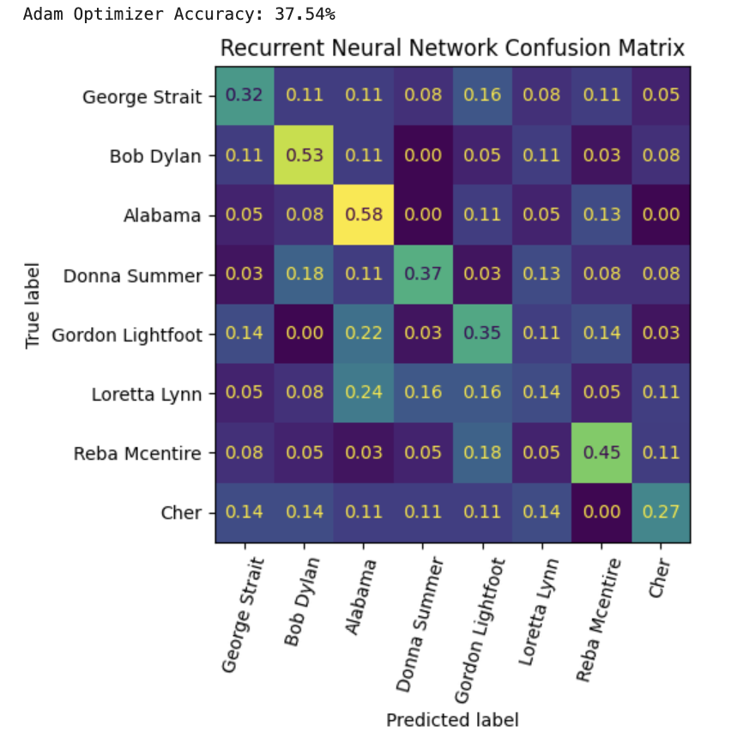
Performance Results - Deep Learning
Feed-Forward Neural Network
Recurrent Neural Network
Neural Embedding

Slide 17
Conclusions
Best accuracies:
Random Forest: 41.86%
Feed-Forward Neural Network: 41.53%
Word count found to be more important than semantic relationships

